Slide 1


BANK LOAN ANALYTICS
By Group-2

Slide 2
MEET THE TEAM
1
2
3
4
5
6
7
GAJJELA NARENDRA KUMAR
SEJAL DINESH BUDAR
ADITYA KAPSE
NUNE BHAVYA SRI
SILVERI CHANDU YADHAV
SHAIK KARISHMA
JAY DWIVEDI

Slide 3
AGENDA
INTRODUCTION
BUSINESS OBJECTIVE
DATASET OVERVIEW
TOOLS
DATA CLEANING & PREPARATION
KPIs
DASHBOARDS
SUGGESTIONS
LIMITATIONS
CONCLUSION

Slide 4
INTRODUCTION
This project focuses on analyzing bank loan customer data to understand customer behavior, loan performance, and repayment patterns.
Using data analytics tools, we identify risks, trends, and key insights that help banks make better financial decisions.

Slide 5
BUSINESS OBJECTIVE
Analyze bank loan performance and repayment behavior
Identify high-risk and low-risk customers
Track trends using key financial KPIs
Support data-driven lending decisions

Slide 6
DATASET OVERVIEW
Domain: Finance
Project: Bank loan of customers
Dataset Type: Excel Data
Datasets: Finance_1.csv & Finance_2.xlsx
Dataset Size: Each Excel file has 39k+ records

Slide 7
TOOLS USED
EXCEL
MYSQL
POWERBI
TABLEAU

Slide 8
DATA CLEANING & PREPARATION
Removed duplicates and handled missing values
Standardized date and numeric formats
Checked data consistency across 2 datasets
Prepared data for KPI analysis and dashboards

Slide 9
Key Performance Indicators (KPIs)
KPI 1: Year wise loan amount Stats
KPI 2: Grade and sub grade wise revol_bal
KPI 3: Total Payment for Verified Status Vs Non Verified Status
KPI 4: State wise and last_credit_pull_d wise loan Status
KPI 5: Home ownership Vs last payment date Stats

Slide 10
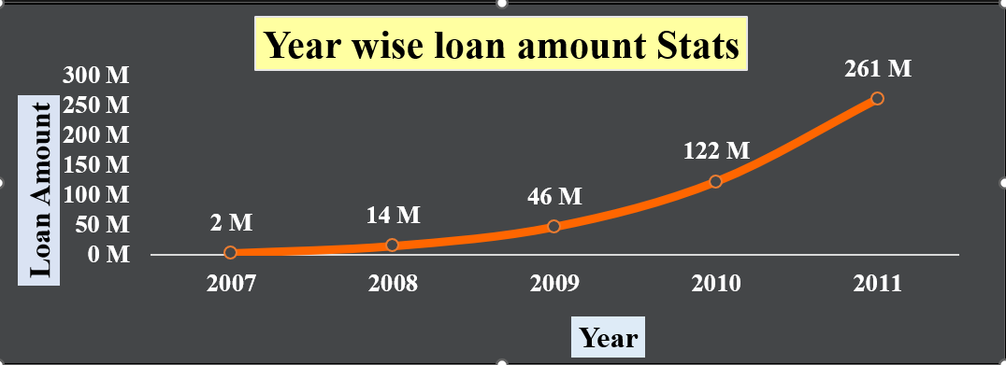
KPI 1: Year-wise Loan Amount
Loan amounts analyzed year by year
Growth trend identified over time
Highest loan amount seen in 2011
Lower loan volume in 2007
Helps understand business expansion
Supports future planning decisions
EXCEL

Slide 11
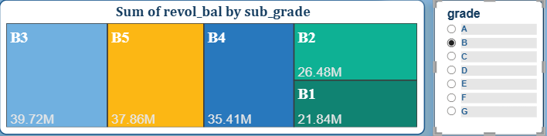
KPI 2: Grade & Sub-grade Analysis
Customers grouped by credit grade
Revolving balance compared across grades
Grade B shows higher credit usage
Higher balance indicates higher risk
Useful for credit monitoring
Helps improve lending policies
POWER BI

Slide 12
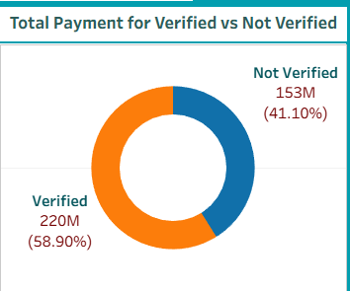
KPI 3: Verification Status Analysis
Customers classified as verified and non-verified
Total payment compared between groups
Verified customers show stable payments
Non-verified customers show higher risk
Important for fraud prevention
Helps strengthen verification process
TABLEAU

Slide 13
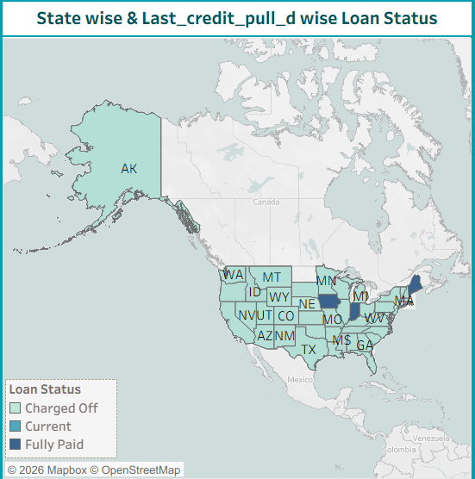
KPI 4: State & and Last_credit_pull_d wise loan Status
Loan performance analyzed by state
Monthly loan trends observed
Identified fully paid loans
Identified charged-off loans
Regional risk patterns identified
Helps location-based strategy planning
TABLEAU

Slide 14
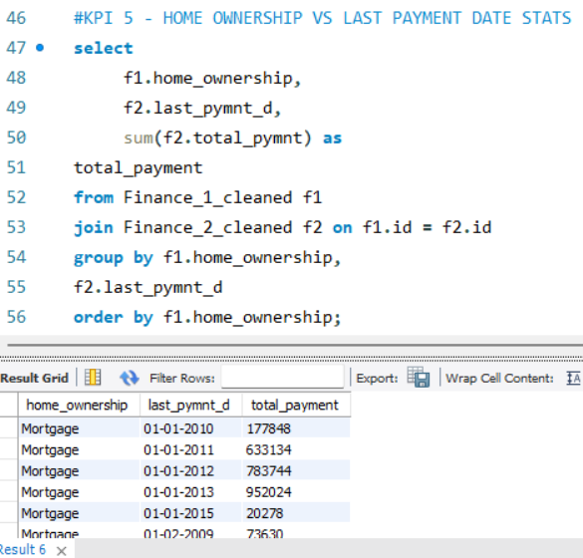
KPI 5: Home Ownership Analysis
Customers categorized by home ownership
Categories include rent, own, mortgage
Mortgage customers take larger loans
Rent customers show smaller loan values
Ownership impacts repayment behavior
Useful for customer profiling
MY SQL

Slide 15
DASHBOARDS

Slide 16
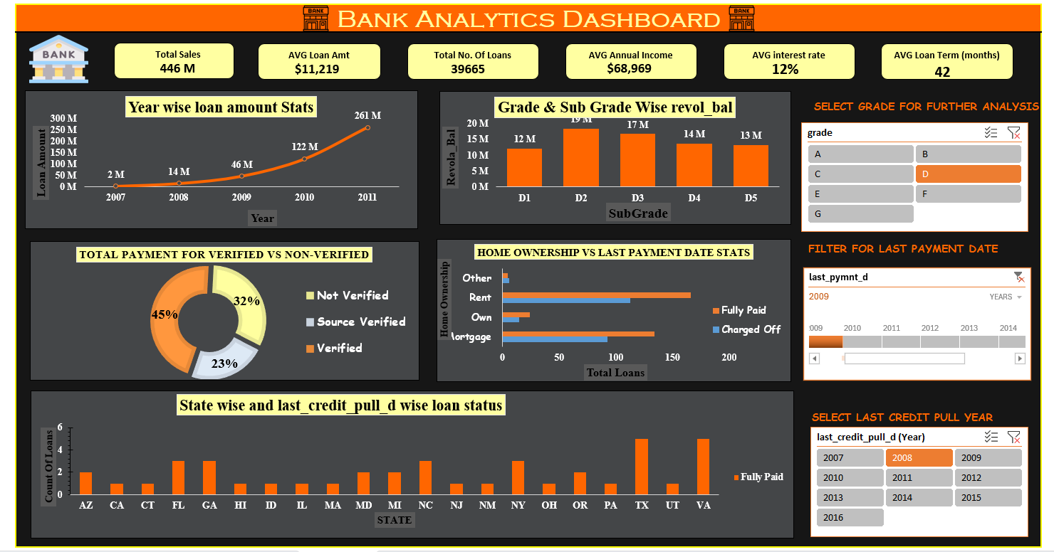
EXCEL DASHBOARD

Slide 17
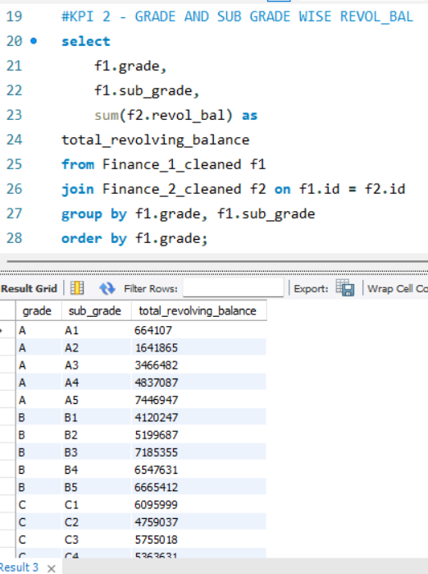
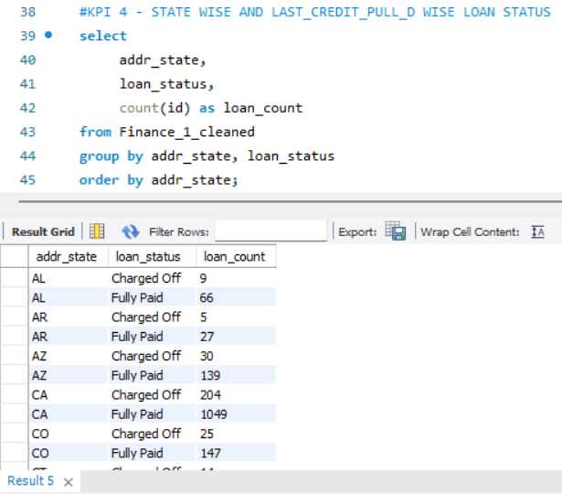
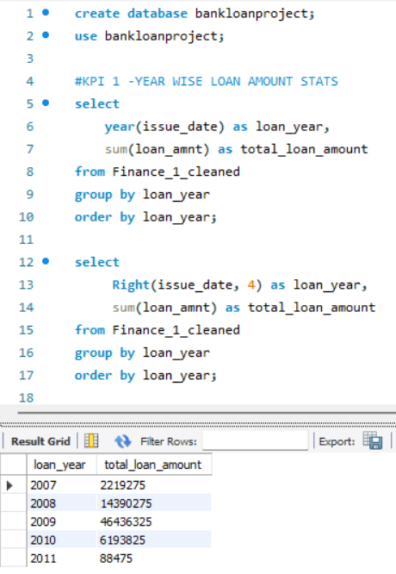
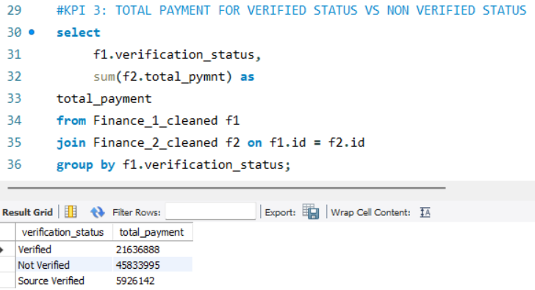
MY SQL

Slide 18
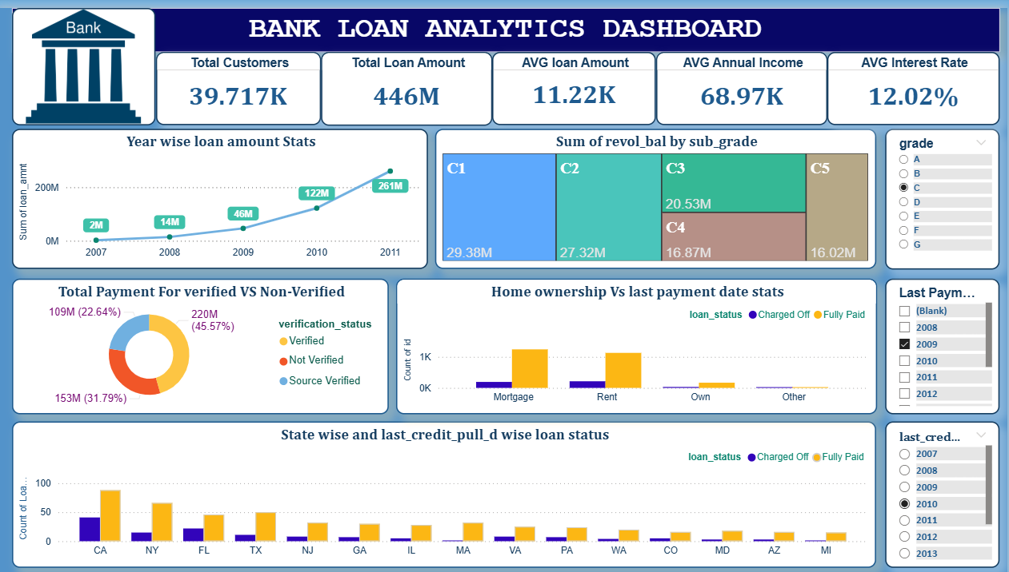
POWER BI DASHBOARD

Slide 19
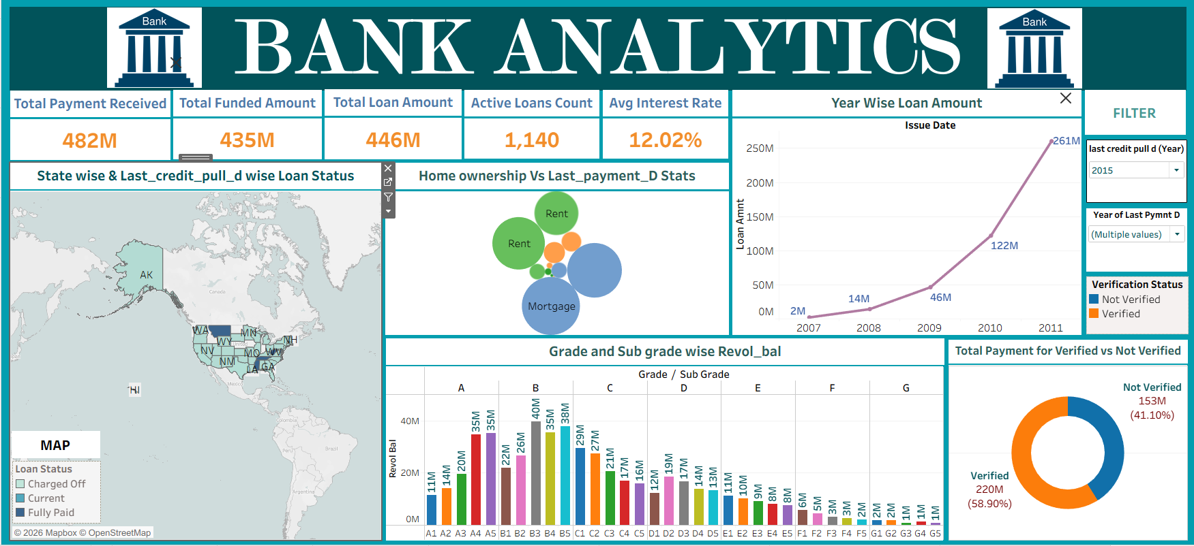
TABLEAU DASHBOARD

Slide 20
SUGGESTIONS
Give priority to high-grade loans (A & B) as they show lower risk
Be strict with low-grade loans (D, E, F) due to higher default chances
Prefer verified customers since their repayment behavior is better
Check revolving balance before loan approval to control credit risk
Use state-wise loan analysis to reduce regional concentration risk

Slide 21
LIMITATIONS
Dataset does not include economic factors (inflation, interest rates)
Some records have missing payment or credit details
Data is historical, not real-time

Slide 22
CONCLUSION
This project analyzed bank loan data to understand risk and repayment patterns.
High-grade and verified customers were found to be more reliable borrowers.
Customers with high existing debt require careful loan evaluation.
The analysis provides useful insights, but the data is historical and limited.

Slide 23
Thank you

